Slide 1


Galaxy surveys
We will discuss:
Why galaxy surveys are important
The first generation of large sky surveys
Contribution from HST
Future
Themiya Nanayakkara
@themiyan
With contributions from Prof. Rychard Bouwens and Dr. Jacqueline Hodge : Leiden Observatory

Slide 2
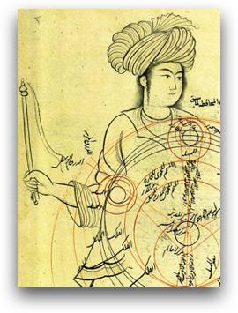

What is a galaxy? A historical perspective
Horoscope of Prince Iskandar, grandson of Tamerlane, the Turkman Mongol conqueror, by Imad al-Din Mahmud al-Kashi, from The Book of the Birth of Iskandar (ca. 1384) – Source: Wellcome Library, London.
Depiction of an epicyclic planetary model. Qutb al-Din al-Shirazi (1236 – 1311)
Notes:
Here you see two examples from history
that showed that ancient people observed the sky with quite some interest
On the left you see a depiction of an epicyclic planetary model,
and on the right you see a HOROSCOPE based on the motions of celestial bodies.
Identification of EXTRAGALACTIC objects (as different to stars) are scarce,
although records show that Persian astronomers observed
our closest spiral galaxy Andromeda
as well as the Large Magellanic Cloud in the 10th century.
----
Refs:
Oscar

Slide 3
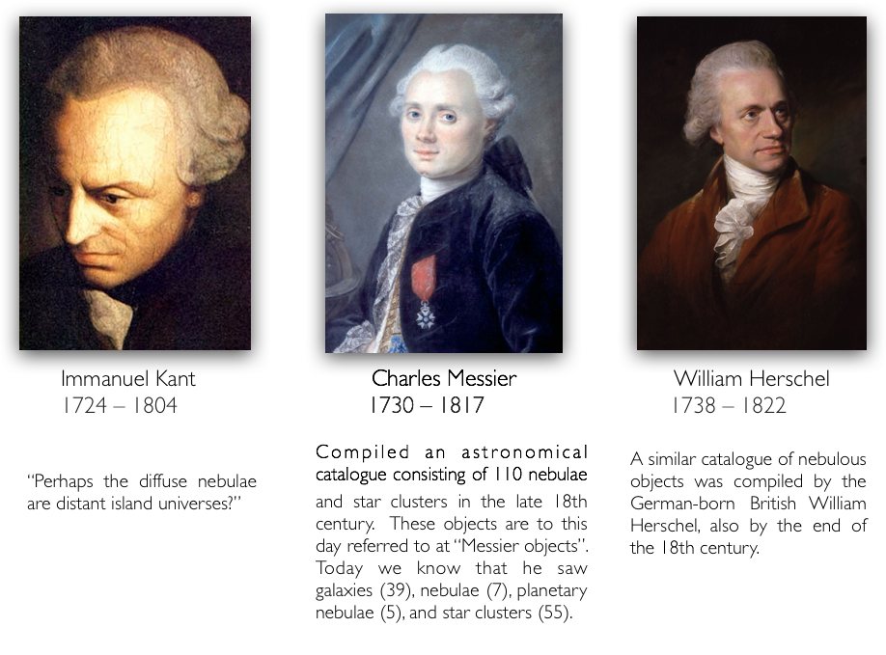
What is a galaxy? A historical perspective
Notes:
-Immanuel Kant was one of the first to speculate that…[ ]
---
Refs:
-Oscar

Slide 4
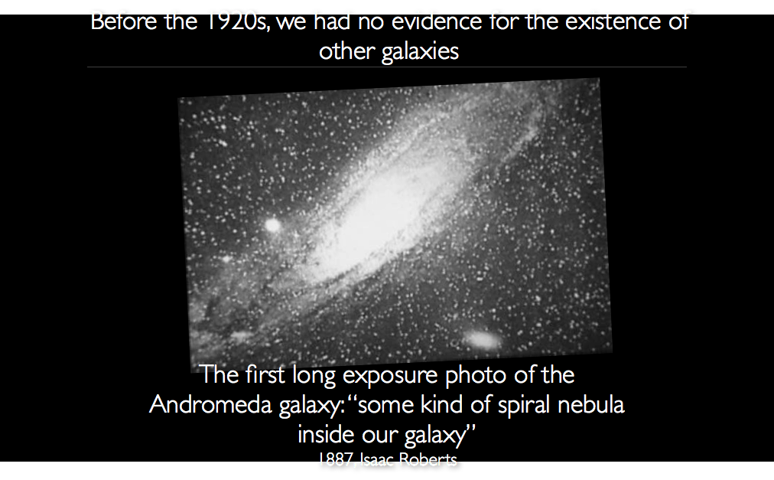

Slide 5
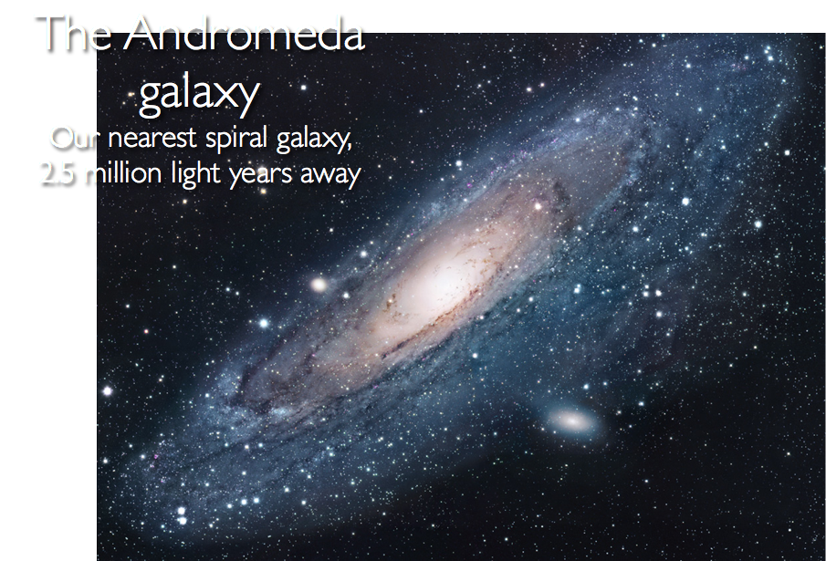
Notes:
---
Refs
-Oscar

Slide 6
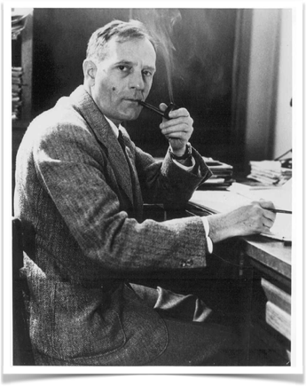
Edwin Hubble
In the 1920’s, Hubble observed variable stars in the Andromeda ‘nebula’ M31. Assuming these stars had the same luminosities as Cepheid variables within our Galaxy, he concluded that M31 must be at least 300 kpc away.
Photo courtesy Observatories of the Carnegie Institution of Washington
Courtesy Carnegie Observatories
Notes:
-In the 1920s…[ ]
-You can see he had originally written ‘N’ = Nova
-However, one of the so-called nova dimmed and brightened
over a much shorter time period than seen in typical nova.
-He determined it was actually a Cepheid variable.
---
Refs:
-Oscar

Slide 7
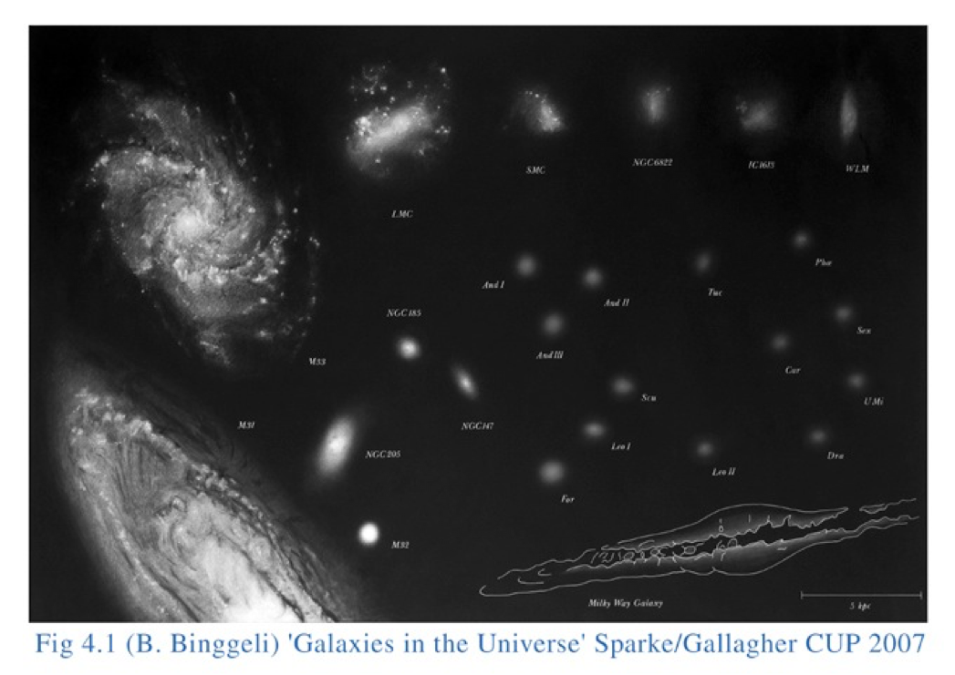
The local group
Notes:
-Then we talked about the other types of galaxies in the LG
-Q: What are they?
-A: 1) Spirals
2) Magellanic clouds (interacting)
3) Dwarf Irregulars (highly SF-ing)
4) Dwarf ellipticals (no gas, old stars)
5) Dwarf spheroidals
----
Ref:
Book

Slide 8
C. North, M. Galametz & the Kingfish Team
Notes:
-Galaxies come in a very WIDE range of different morphologies,
and any complete theory of galaxy evolution should be able to explain this observation.
-Here you see what’s called the Hubble tuning fork as seen by the Herschel Space Telescope
-We will talk in more detail about the different CLASSES of galaxies shown here,
but the thing to take away from this slide
is that galaxy shapes are extremely diverse:
-From large spiral galaxies, to a messy collection of stars,
and everything in between.

Slide 9
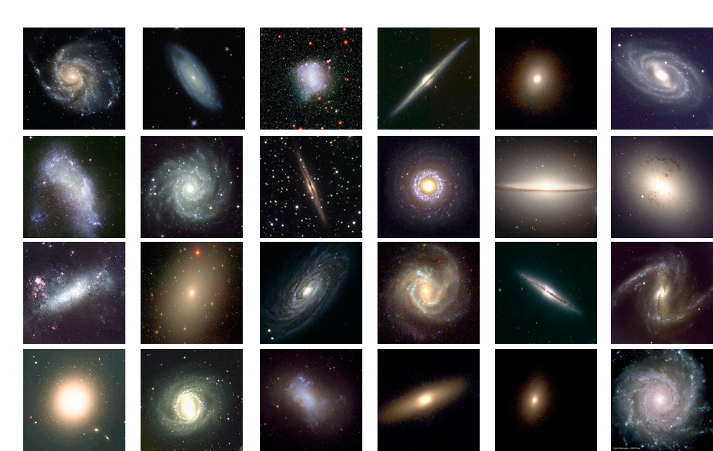
Beyond the local group
Notes:
Q: What properties can we measure from these galaxies?
A: e.g., Color, luminosity, shape, profile

Slide 10
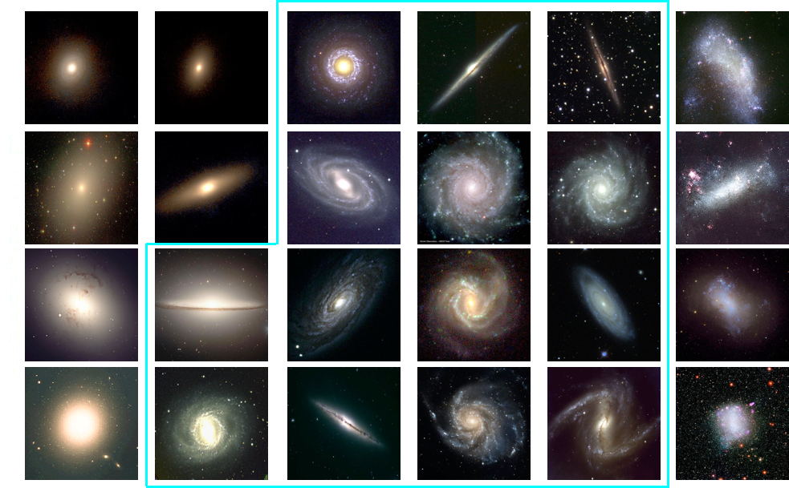

Slide 11
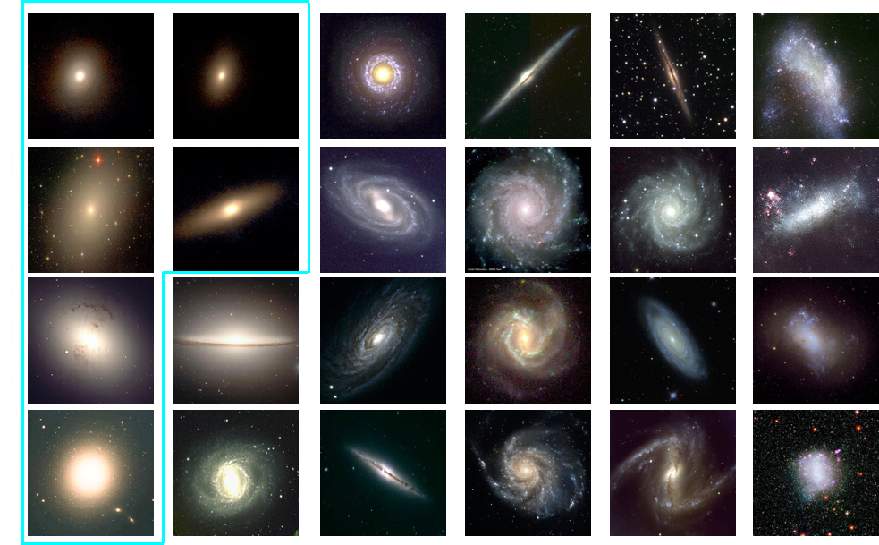

Slide 12
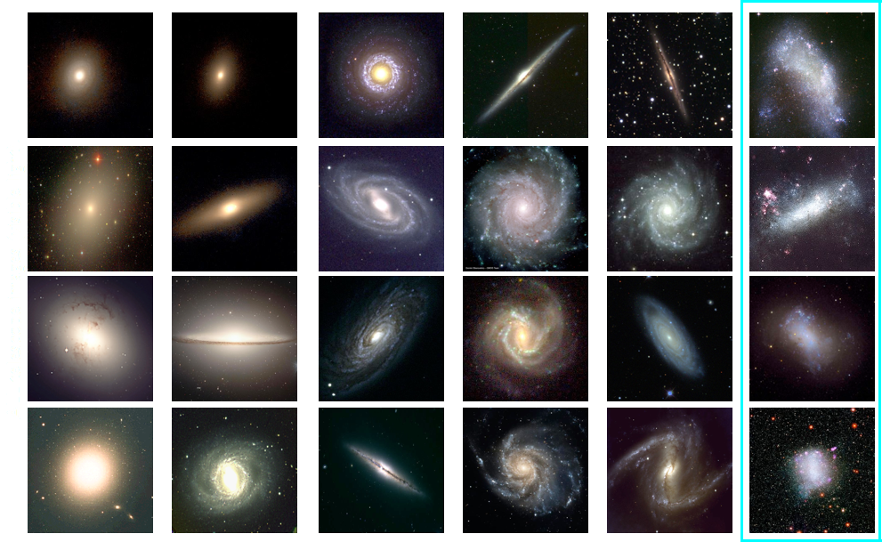

Slide 13
Why galaxy surveys
To perform statistically significant analysis of galaxy evolution it is important to:
Observe complete samples of galaxies (e.g. mass, magnitude etc.)
Obtain multi-wavelength photometric data
Supplement with spectroscopy
Galaxy surveys can be
all sky surveys focusing on a wide are but shallow
deep surveys with limited sky coverage but probing fainter and high redshift targets

Slide 14
2dFGRS
~250,000 spectra covering ~1500 sq deg
Contributed significant advancements to cosmology

Slide 15
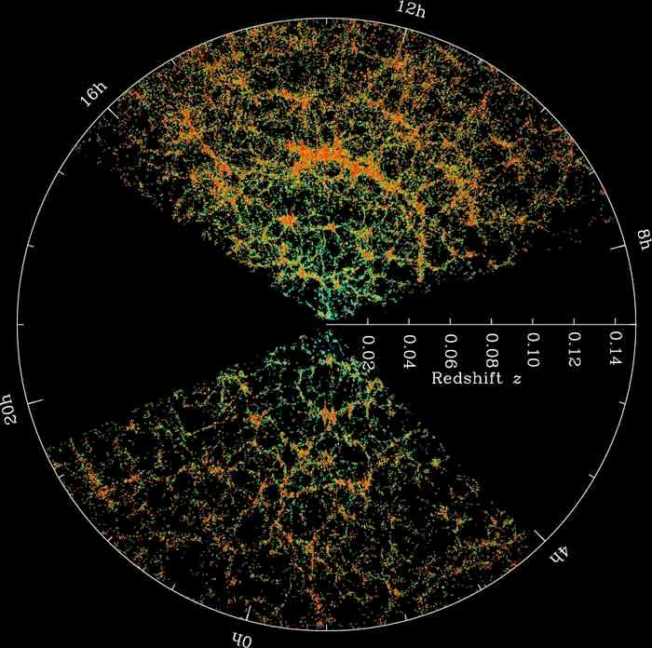
SDSS
SDSS revolutionised our understanding of galaxy evolution
100 million + galaxies observed along with 1 million + galaxy spectra so far
Notes:
-This is a plot of sky coordinates versus distance for galaxies from the Sloan Digital Sky Survey
-The Earth is at the center
-This shows the DISTANCE to all galaxies in a NARROW STRIP of sky
-The densest regions are areas where many galaxies are clustered together.
-What you should notice is that the distribution is NOT RANDOM
-There are clusters, and there are CLUSTERS OF CLUSTERS --
the end results is sometimes described like soap bubbles
-There is a LSS to the universe

Slide 16
GAMA survey
GAMA: Galaxy And Mass Assembly
Includes around ~300,000 galaxy spectra
Complemented by IFU observations by SAMI survey of ~3000 galaxies

Slide 17
Movie showing the fly though in galaxies using GAMA redshifts
http://astro.dur.ac.uk/~ams/GamaMovie/
Notes:
http://astro.dur.ac.uk/~ams/GamaMovie/

Slide 18
These surveys have contributed immensely to our understanding of the Universe
Some key results include:
Bimodal distribution of galaxies in the local universe and its implications to galaxy evolution (e.g. Baldry et al., 2004; Menci et al., 2005; Martinez et al., 2006)
Constraints on star-formation quenching mechanisms (e.g. Baldry et al., 2006; Cortese & Hughes, 2009; Davies et al., 2016)
IMF and its universality (Baldry & Glazebrook, 2003; Hoversten & Glazebrook, 2008; Gunawardhana et al., 2011)
The discovery of low surface brightness and faint dwarf galaxies in the local universe and their population properties (e.g. Zucker et al., 2004; Barazza et al., 2006; Williams et al., 2016)
The discovery of methane dwarfs (Strauss et al., 1999; Tsvetanov et al., 2000)
The discovery of populations of high redshift quasars (Fan et al., 2001, 2003, 2004, 2006), merger histories of galaxies (e.g. Bell et al., 2006; Ferreras et al., 2017)
Constraints on the cosmological parameters from the local universe (e.g. Budav ́ari et al., 2003; Tegmark et al., 2004; Eisenstein et al., 2005; Gheller et al., 2016)

Slide 19
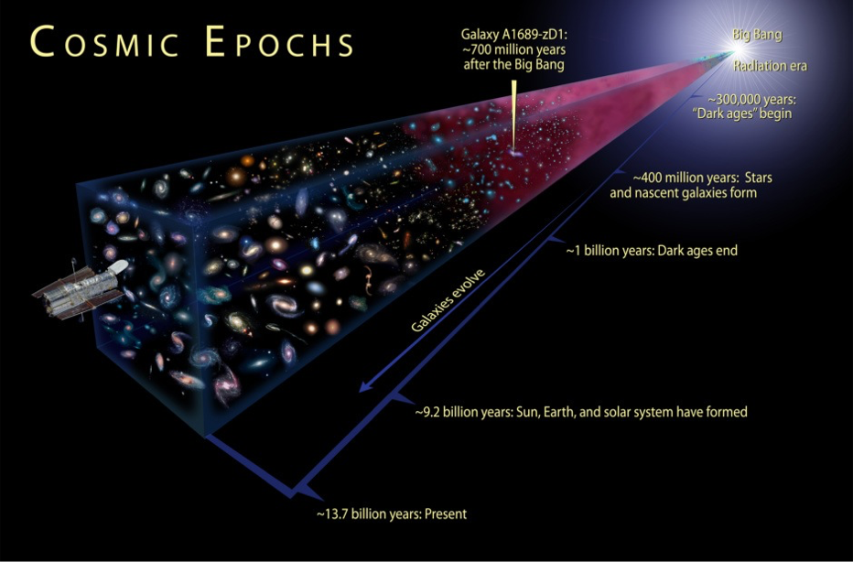
To study high-z galaxies we need to go deeper in the expense of FoV

Slide 20
Hubble deep fields
Hubble space telescope advanced our understanding of the early Universe
Deep multi-wavelength exposures in multiple pointings in the sky e.g. COSMOS, GOODS-N/S, HDFS, EGS, UDS
Opened up a new window to study cosmic galaxy evolution
These fields are supplemented by many other ground and space based observations
Some large legacy programs include CANDLES, RELICS, BUFFALO

Slide 21
HUDF fly though video
Click here for the link
Notes:
https://r2---sn-a5meknee.googlevideo.com/videoplayback?itag=18&gir=yes&ipbits=0&ratebypass=yes&mime=video%2Fmp4&requiressl=yes&clen=2295034&expire=1543568699&fvip=3&pl=22&c=WEB&sparams=clen%2Cdur%2Cei%2Cgir%2Cid%2Cinitcwndbps%2Cip%2Cipbits%2Citag%2Clmt%2Cmime%2Cmm%2Cmn%2Cms%2Cmv%2Cpl%2Cratebypass%2Crequiressl%2Csource%2Cexpire&initcwndbps=3980000&mn=sn-a5meknee%2Csn-n4v7knlz&signature=545813E1B5FD6B2C6DF2550A488126B52C014065.1449F6C4E45D1583A3268E6C0BFCAD419366876F&mm=31%2C26&ip=173.232.7.186&key=yt6&lmt=1388230106441961&source=youtube&dur=58.444&mv=m&mt=1543546972&ms=au%2Conr&id=o-AAnsmjJKRHqu00-FgVcVr3gqb6DyA2W_t7852xWJOb71&ei=26gAXPiHIsKB7gO3n6nwBg&video_id=PDMp8a-YNe0&title=Hubble+Ultra+Deep+Field+3-D+Fly-Through

Slide 22
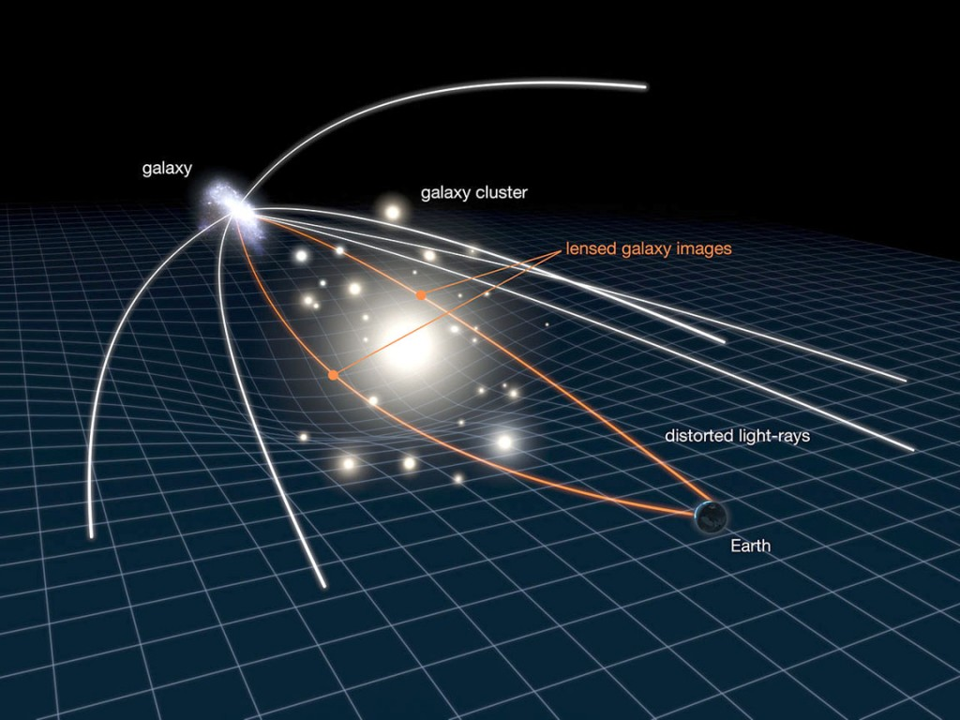
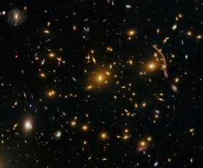
Pushing further with HST
Find a Massive Object that magnifies a significant volume of the universe
Increase Sensitivity
Decrease Volume
Massive Galaxy Cluster

Slide 23
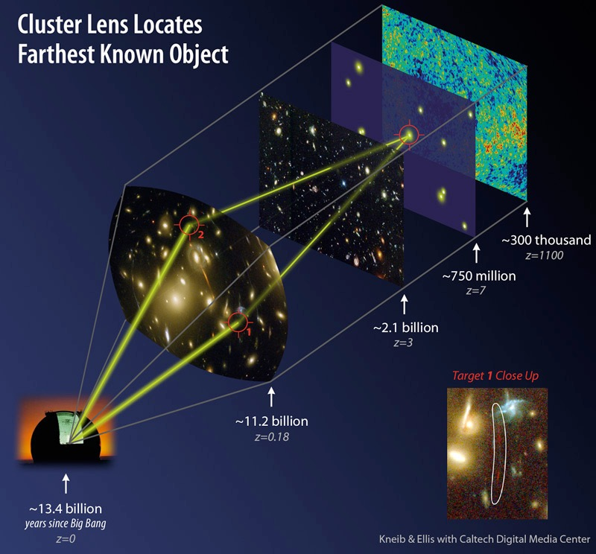
Boosting the signal with gravitational lenses
massive clusters of galaxies act like telescopes
magnify galaxies behind (far behind - far back in time)
magnified “lensed” galaxies are distorted into long curved shapes
allows us to see galaxies at high redshift in otherwise-impossible detail.

Slide 24
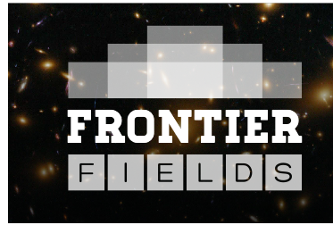
What is the trick to try to push fainter?
Target that region of the sky with very deep observations with Hubble and other powerful telescopes
Massive Galaxy Cluster
Integrate for 140 orbits
with Hubble
70 orbits in the optical
70 orbits in the near-IR
Notes:
----- Meeting Notes (10/13/14 19:42) -----
0:45

Slide 25

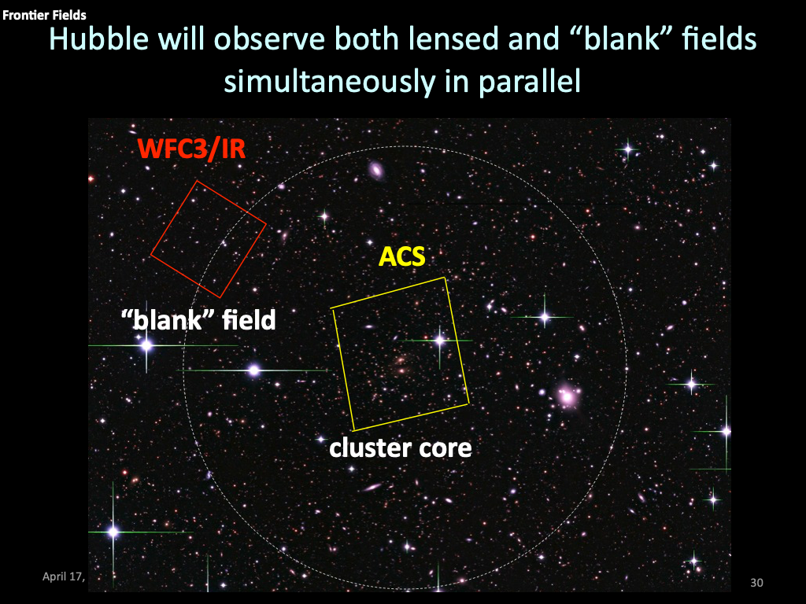
Hubble has observed both lensed and “blank” fields simultaneously in parallel

Slide 26
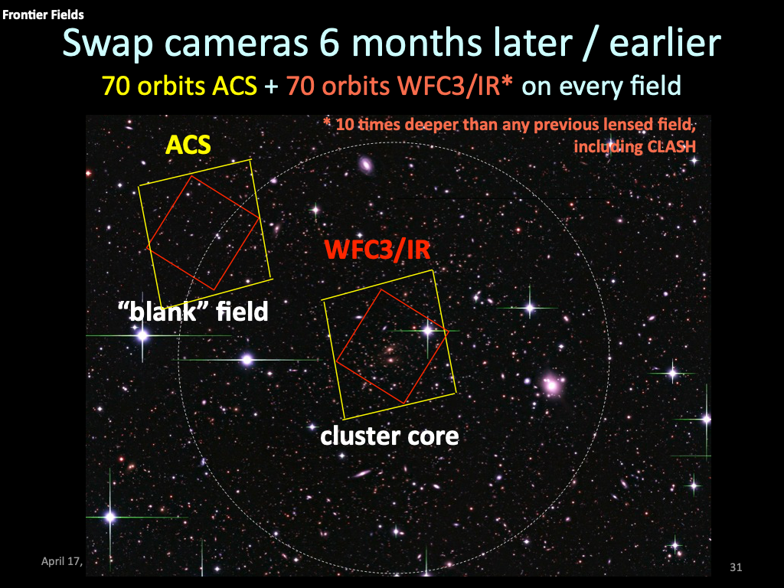

Slide 27
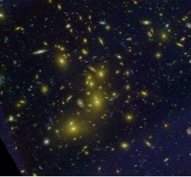
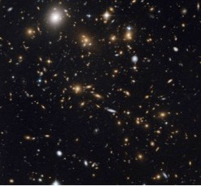
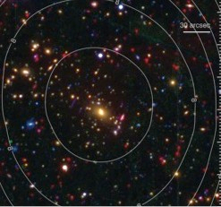
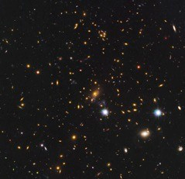
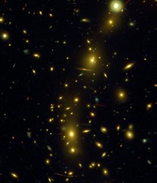
Repeat this over six massive clusters to improve the statistics and control for cosmic variance
Abell 2744
MACS0717
RXJ2248
M0416
MACS1149
Abell 370
spending 840 orbits
Notes:
----- Meeting Notes (10/13/14 19:42) -----
0:45

Slide 28
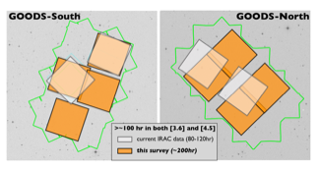
Even Deeper Spitzer/IRAC Observations
e.g. 732-hour GREATS program (PI Labbe)
200 hour depth IRAC data over 200 arcmin²
26.7 mag at 5σ
Enable Individual detections [OIII], Hα for 0.5 L* galaxies
70

Slide 29
Role of spectroscopic surveys
Redshift information crucial to constrain evolutionary properties
Surveys from instruments such as MUSE have contributed significantly to enhance the product value of Hubble observations

Slide 30
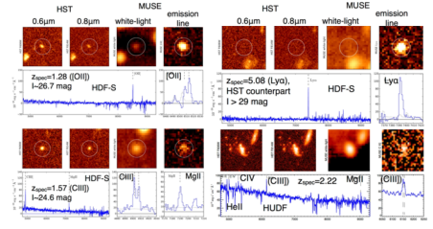
MUSE
Current observations have gone deeper than HST in UDF alone with 1000+ galaxy redshifts at high-z
Currently undertaking a single 160h exposure: The DEEPEST pointing in the Universe

Slide 31
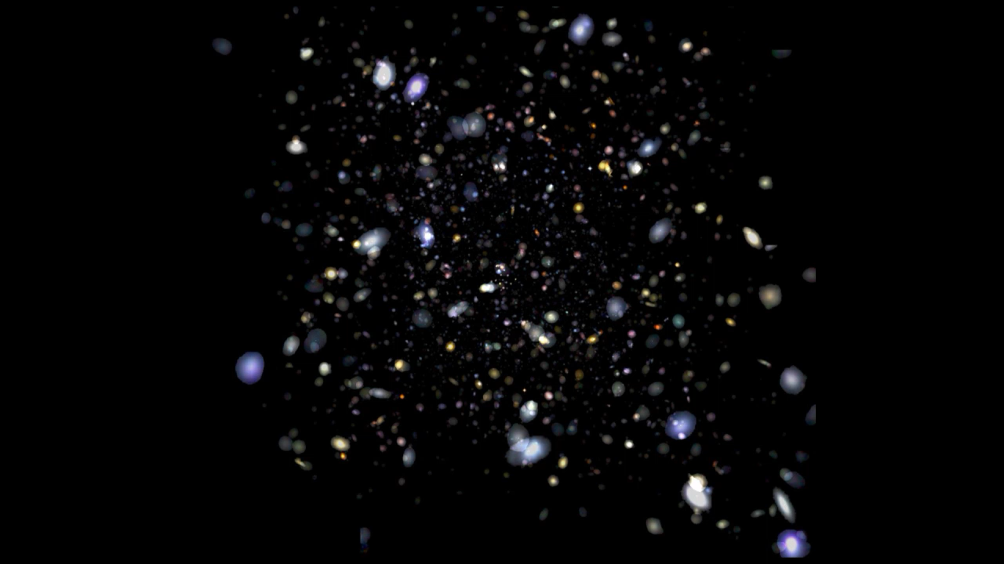

Slide 32
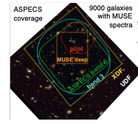
Sub-mm observations from ALMA

Slide 33
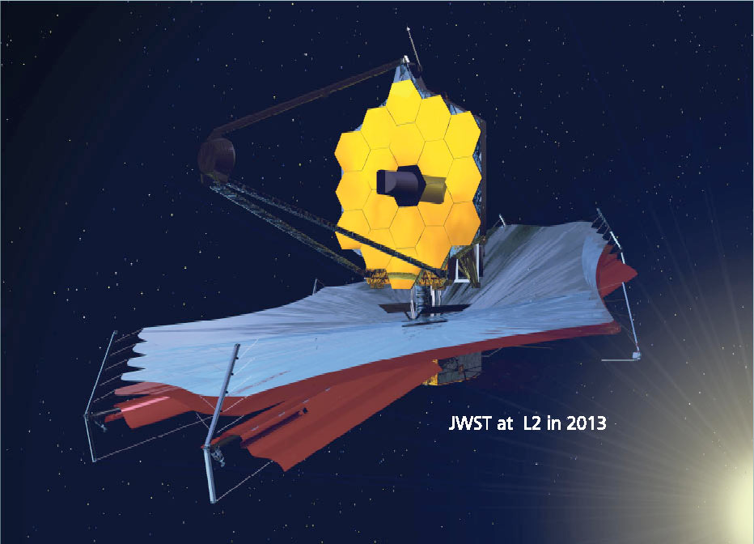
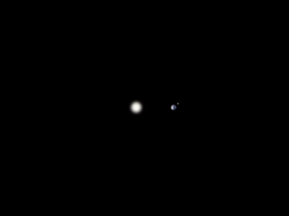
JWST
Scheduled to be launched in 2021
Will observe in Near and mid-Infra red up to 28μm

Slide 34
JWST mirror size comparison video
https://svs.gsfc.nasa.gov/vis/a010000/a010700/a010776/JWST-HST_Mirror_Compare_appletv.m4v

Slide 35
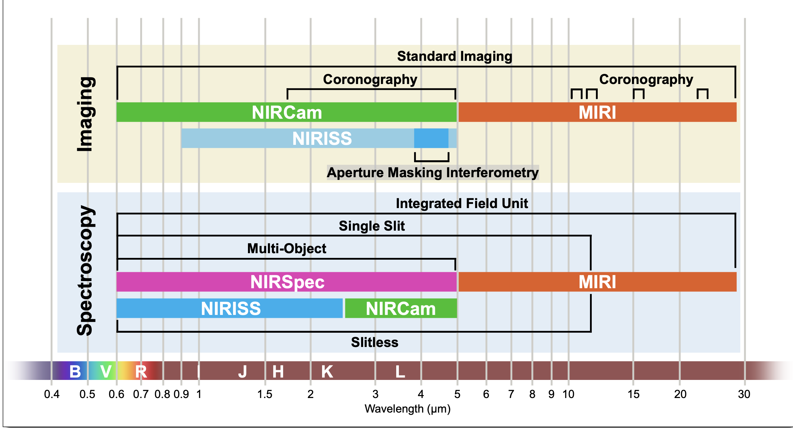

Slide 36
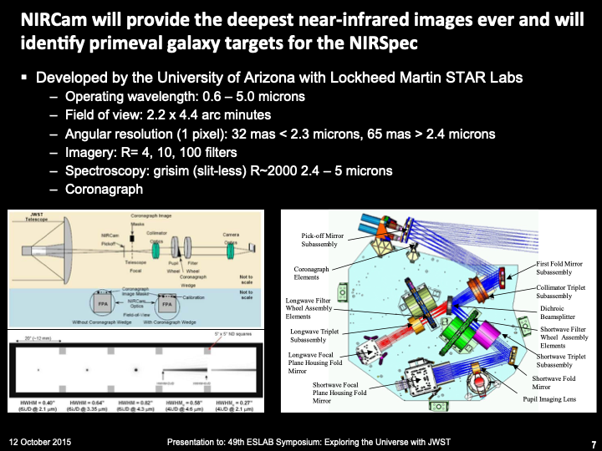

Slide 37
WFC3/IR serves as an essential pathfinder (at <2μ)
HST
NICMOS (1998-2008)
HST
WFC3/IR
JWST
NIRCAM
0.8 arcmin
(2009-)
40x Improvement
(2021-)
(6x area,
3x sensitivity
2x resolution)
2.2 arcmin
40x Improvement
(2x area,
7x sensitivity,
1.5-2x resolution,
duplexing)
2.2 arcmin

Slide 38
Spitzer IRAC Pathfinder at 2-5μ
Spitzer
IRAC
(2004-)
JWST
NIRCAM
(2021-)
>1000x Improvement and
few confusion issues
5.2 arcmin
(70x sensitivity,
10x resolution,
0.35x area)
2.2 arcmin

Slide 39
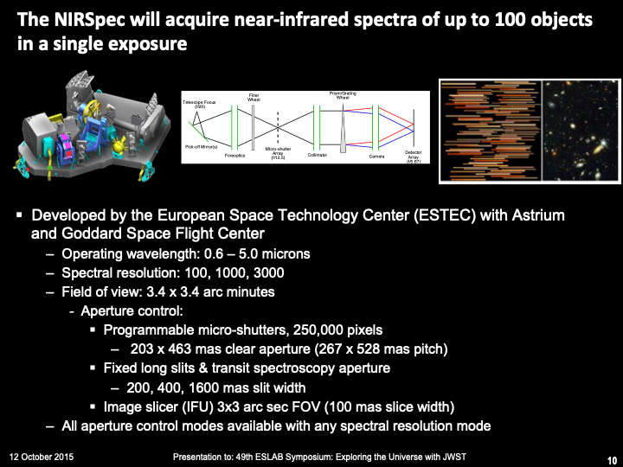

Slide 40
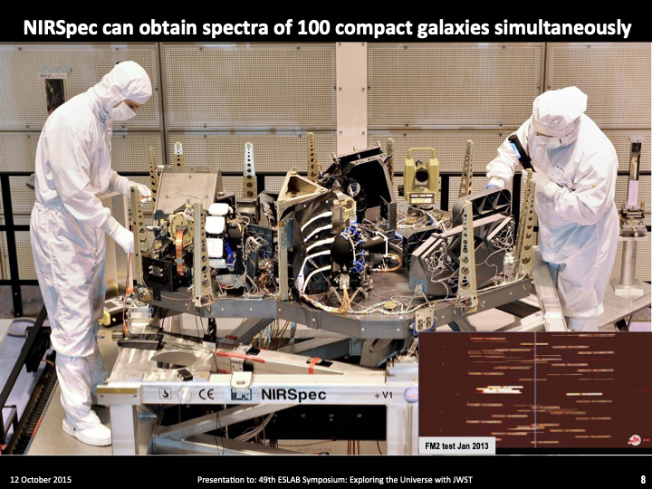

Slide 41
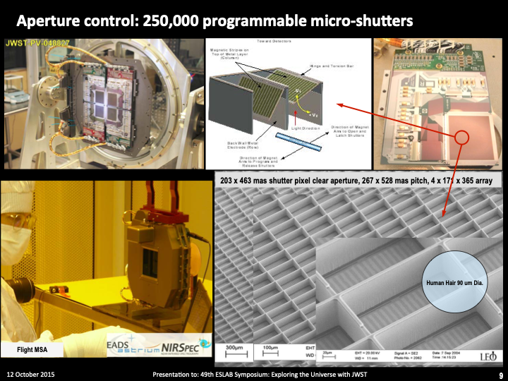

Slide 42
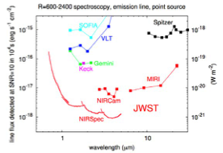

Slide 43
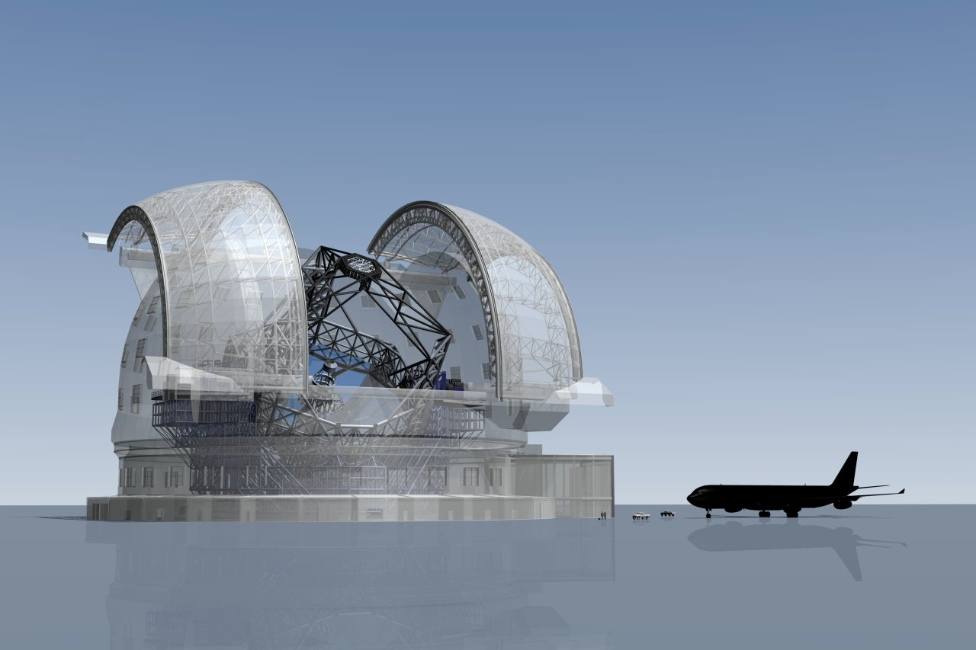
European Extremely Large Telescope
39-meter diameter
(2024+)

Slide 44
ELT trailer https://cdn.eso.org/videos/hd_and_apple/elttrailer_es.m4v

Slide 45
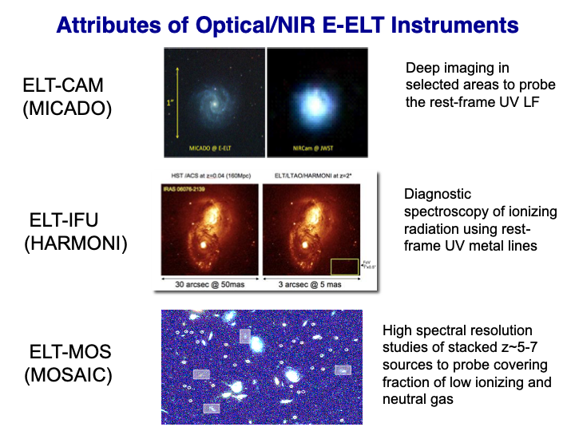

Slide 46
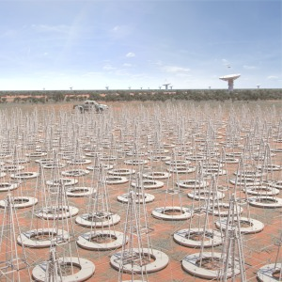
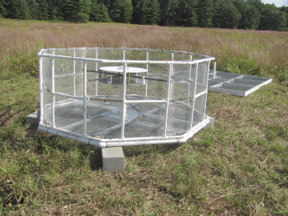
21cm observations: HERA and SKA
The Hydrogen Epoch of Reionization Array (HERA)
(Pober et al. 2014; DeBoer et al. 2016) is drawing on
lessons learned by the MWA and PAPER to reach the
calibration and foreground isolation accuracy required to
make a signicant detection and characterization of the
cosmological signal.
should detect the EOR power spectrum at z 9 with a signal-to-noise ratio of 19.3
Square Kilometer Array
HERA prototype (Neben+16)
Hydrogen Epoch of Reionization Array (HERA;Pober+14)
Improving Calibration and foreground isolation accuracy w experiences of PAPER and MWA (redundant baseline-> redundant calib.)
Aiming a 21cm power spectrum detection w S/N~20 at z~9
Square Killometer Array (SKA; ~2030)

Slide 47
SKA Aus-NZ promotional video https://www.youtube.com/watch?v=9y8QGJRZPSk

Slide 48

Post JWST

Slide 49
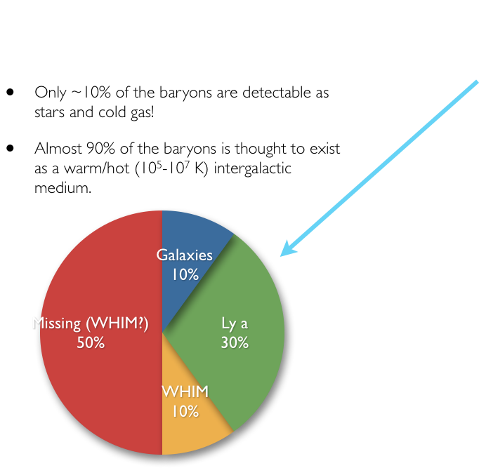
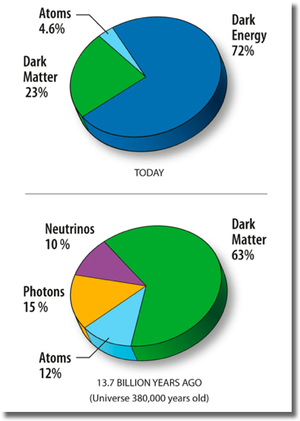
The cosmic inventory
Is it all observed then?
Notes:
-Note also that this division was DIFFERENT AT DIFFERENT STAGES in the Universe
-For example, right after the BB….

Slide 50
The most interesting things are yet to come…..

